Slide 1

Social Media Design Guide

Slide 2

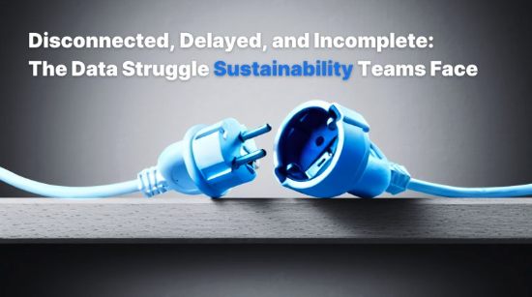

Black & white images with blue accents
Simple imagery used to convey simple message
Chaotic AI-generated image with manual blue outline
To demonstrate volumes of data or mountains of data.
Images should talk to the metaphors.
“gated data or representing that they keep data to themselves & don’t share”

Slide 3

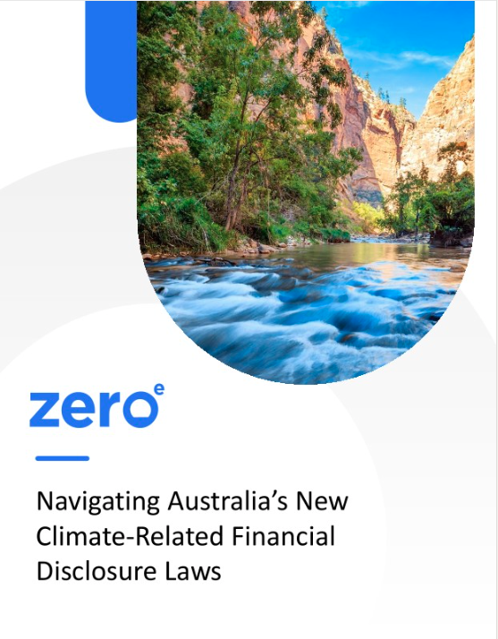
Info sheets and guides / social posts
Nature images in frames with soft and smooth corners
Light grey graphics to offset the white
Blue accents where needed.

Slide 4
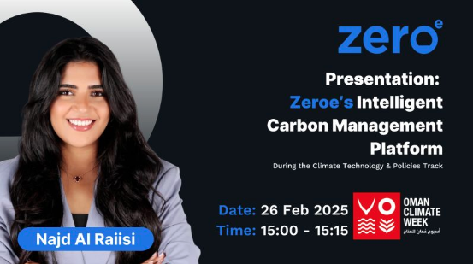
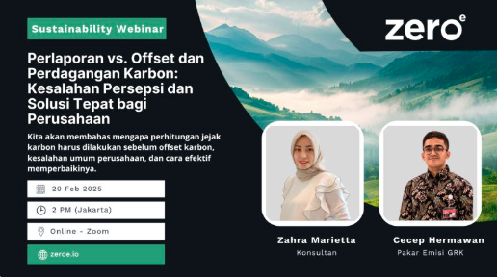
Speak and Event posts
high contrast colours
Soft curves
Subtle features to break up text where needed

Slide 5
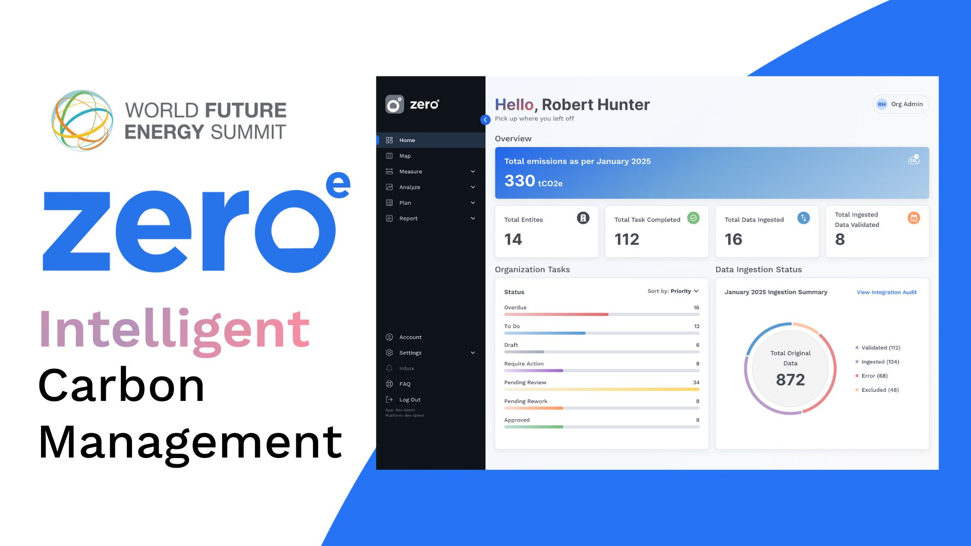
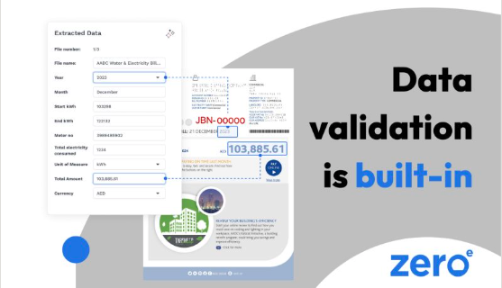
Platform and product posts
Simple approved UI graphics and call-outs
The blue and dark grey backgrounds here are incorrect. They should be light grey

Slide 6
Brand Identity & Visual Language
1.1 Colour Palette
Primary Blue: #2673ea (Zeroe Blue) – Used for highlights, accents, and call-to-action elements.
Black & White: Used for contrast, typography, and professional aesthetics.
Light Grey Accents: Used to balance elements when needed.
1.2 Typography
Headline Font: Outfit (Bold, uppercase for emphasis)
Body Font: Geist (Light to Medium weight, easy to read)
Hierarchy:
  Headlines should be bold and impactful.
  Subheadings should use medium weight.
  Body text should be clear and structured.
1.3 Logo Usage
The Zeroe logo should be placed in top-right or bottom-left corners.
Maintain white space around the logo to avoid clutter.

Slide 7
Visual Elements & Composition
2.1 Design Toolbox
Zeroe’s design elements should reflect innovation, clarity, and credibility. Designers have multiple visual options:
AI-Generated Black & White Imagery with blue accents (optional, used for a high-tech feel).
Full-color, high-contrast images when showcasing UI elements or human-centric storytelling.
Abstract data-driven visuals for insights, statistics, and infographics.
UI Screens & Graphical Elements with blue highlights for feature showcases.
Clean, structured layouts with proper alignment and hierarchy.
2.2 Use of Blue Accents
Blue should be used strategically to highlight key elements, such as callouts, UI features, and important stats.
In black-and-white images, blue outlines or flow elements should add a futuristic, data-driven feel.
Avoid overusing blue—keep it subtle and effective.
2.3 Image & Copy Cohesion
Every visual must align with the copy’s message. No random stock imagery.
Pain Point Posts: Visuals should represent data silos, manual work struggles, or ESG complexity.
Solution Posts: Show automated workflows, simplified dashboards, and streamlined processes.
Industry Insights: Use graphs, clean numbers, and structured layouts.
Events & Thought Leadership: Professional speaker images with blue highlights and clear event details.

Slide 8
Post Types & Their Visual Execution
3.1 Product Feature Posts
“Platform showcase”
Copy Focus: Highlighting Zeroe’s platform automation and intelligence.
Visuals:
  Clean UI screenshots with floating blue callouts.
  Minimalist tech imagery (e.g., data flows, dashboards in focus).
Example:
  Copy: "Automate your sustainability reporting with Zeroe. No more chasing data."
  Image: Zeroe dashboard with blue highlights on key data points.

Slide 9
Post Types & Their Visual Execution
3.2 Pain Point Awareness Posts
“Challenges in ESG & Carbon accounting”
Copy Focus: Addressing common struggles like fragmented data and compliance issues.
Visuals:
  Black-and-white chaos visuals with a blue streamlined solution.
  Comparisons: Before/After mockups of manual vs. automated processes.
Example:
  Copy: "Disconnected data makes emissions reporting a nightmare."
  Image: Scattered spreadsheets (B&W) vs. a unified Zeroe dashboard (blue highlighted).

Slide 10
Post Types & Their Visual Execution
3.3 Solution-orientated Posts
“How Zeroe Fixes it”
Copy Focus: Demonstrating Zeroe’s seamless, efficient solutions.
Visuals:
  Before/After Split-Screen Designs.
  Flow diagrams with blue-highlighted automation paths.
Example:
  Copy: "From spreadsheets to a single dashboard—Zeroe simplifies sustainability reporting."
  Image: Before: Messy files → After: Zeroe dashboard with blue glow

Slide 11
Post Types & Their Visual Execution
3.4 Data-driven Insights & industry stats
Copy Focus: Sharing relevant ESG data and trends.
Visuals:
  Minimalist stat designs with blue-highlighted numbers.
  Infographics with clean, readable data points.
Example:
  Copy: "95% of sustainability teams say emissions data is fragmented."
  Image: Bold "95%" in blue with structured layout and a subtle data flow background.

Slide 12
Post Types & Their Visual Execution
3.5 Event & Thought leadership promotions
Copy Focus: Promoting webinars, speaking events, and expert insights.
Visuals:
  Speaker headshots in black & white with blue outlines.
  Clear event details structured in blue highlights.
Example:
  Copy: "Join Zeroe’s experts at the Dubai AI & Web3 Festival."
  Image: Event speaker image with blue glow and minimalistic typography.

